Slide 1
ONLINE VOTING SYSTEM
(OVS)

Slide 2
INDEX
Introduction
Objective of Project
Software Requirements
Hardware Requirements
Old Methods Of Voting
Problems with Existing Voting Registration System
Proposed system
Security Issues Of Online Voting
Advantages and disadvantages
Conclusion

Slide 3
INTRODUCTION TO ONLINE VOTING SYSTEM(OVS)
“ONLINE VOTING SYSTEM” is an online voting technique. In this system people who have citizenship of INDIA and whose age is above 18 years and any sex can cast the vote online without going to any physical polling station. There is a database which is maintained in which all the names of voters with complete information are stored.
Registration is mainly done by the system administrator for security reasons. The system Administrator registers the voters on a special site of the system visited by him only by simply filling a registration form to register voter.
After registration, the voter is assigned a secret Voter ID with which he/she can use to log into the system and enjoy services provided by the system such as voting. If invalid/wrong details are submitted, then the citizen is not registered to vote.

Slide 4
OBJECTIVE OF PROJECT
The specific objectives of the project include:
Reviewing the existing/current voting process or approach in INDIA;
Implementing an automated/online voting system;
Validating the system to ensure that only legible voters are allowed to vote.

Slide 5
SOFTWARE REQUIREMENTS
MYSQL DBMS.
Testing- is done via WAMPSERVER.
Web browsers.
Adobe Dreamweaver CS3.

Slide 6
HARDWARE REQUIREMENTS:
Microsoft Windows XP Professional : Packs like SP3/Vista SP1/ 7 /8/ 10.

Slide 7
OLD METHODS OF VOTING
Paper-based voting
Lever voting machine
Direct recording electronic voting machine
Punch card
Optical voting machine

Slide 8
Problems with Existing Voting Registration System
Expensive and Time consuming,
Too much paper work,
Errors during data entry,
Loss of registration forms,
Short time provided to view the voter register

Slide 9
PROPOSED SYSTEM
With the existing system we are planning to implement the online voting through mobiles and internet.
By using our application user can vote from any corner of the world and a authentication is performed to verify the user who is going to vote.
Once the authentication is done password will be sent as message. Then we can show the list of candidates and user can vote.

Slide 10
REQURIEMENTS BEFORE VOTING :
Registration of the voter is done by ELECTION COMMISION OF INDIA.
ELECTION COMMISION OF INDIA can change the information any time as and if required.
Registration of the Voter depends upon the information filled by the user.
Voter is given a unique ID and PASSWORD.
In the DATABASE information of every voter is stored.

Slide 11
Advantages:-
By using our project we can reduce the cost which is used for elections.
This will become a corruption free voting system.
No proxy voting.
Huge amount of time can be saved by voting online.
Secured voting with the One Time Password (OTP) to voters mobile.
Fully secured with FINGER PRINT SCANNER & RETINA SCANNER (OPTIONAL FOR FUTURE USE).

Slide 12
Disadvantages:-
To access this, user must have internet facility.
Should have the knowledge of using web sites.
Should have mobile for receiving OTP.
The OTP can shared to anyone and miss voting can be done.
Secret voting cannot be maintained.

Slide 13
Conclusion
By using this application election can be conducted with good percentage of voting
We can involve more number of citizens in voting
This provides good results for elections.
MAIN AIM: No one should miss the elections in our country. And can be done with less cost, voter friendly and safely.

Slide 14
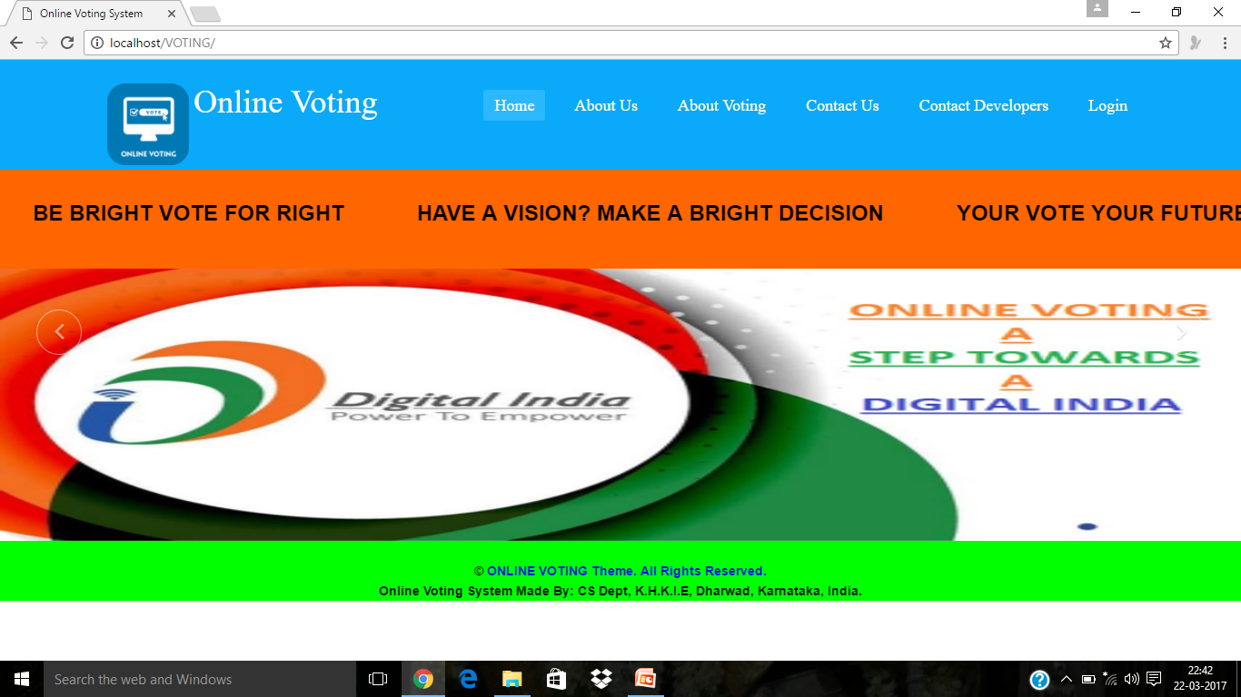
Screen shots of the project main page

Slide 15
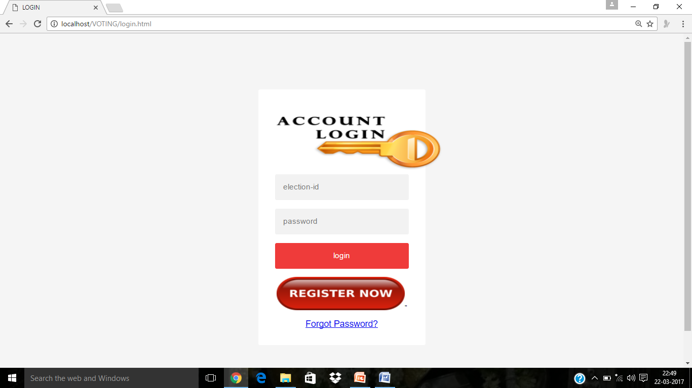
Login page

Slide 16
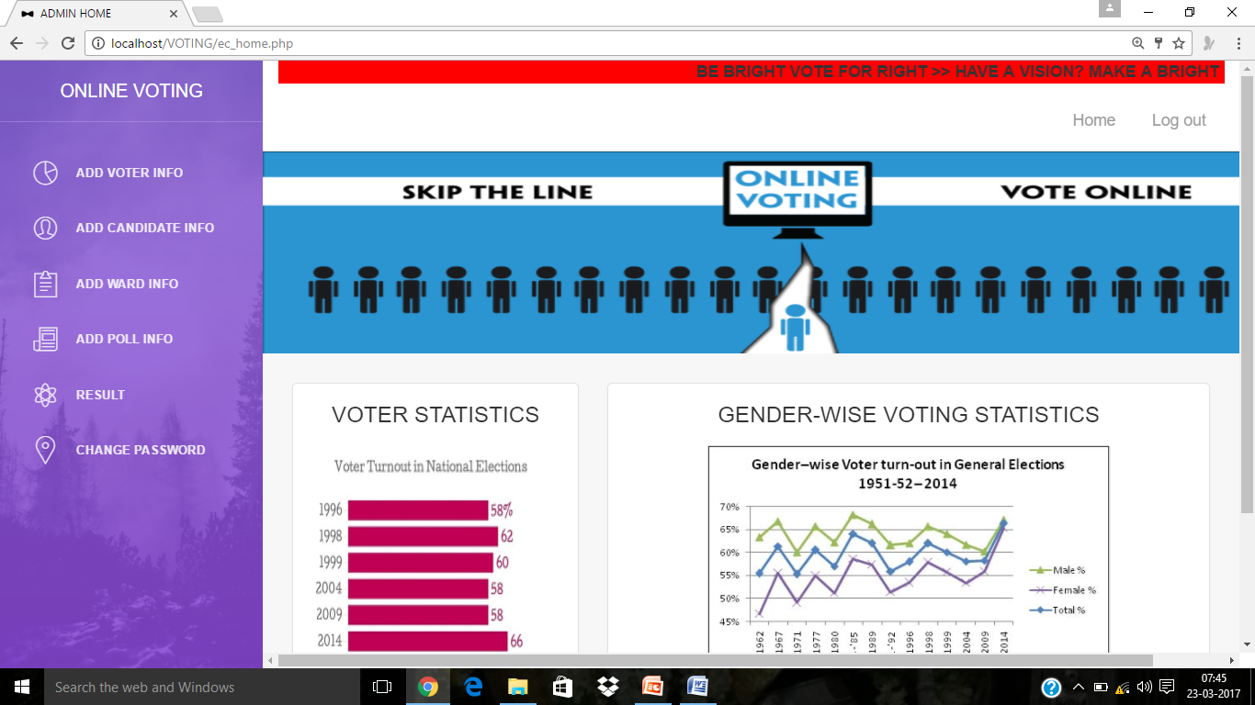
Admin Home page

Slide 17
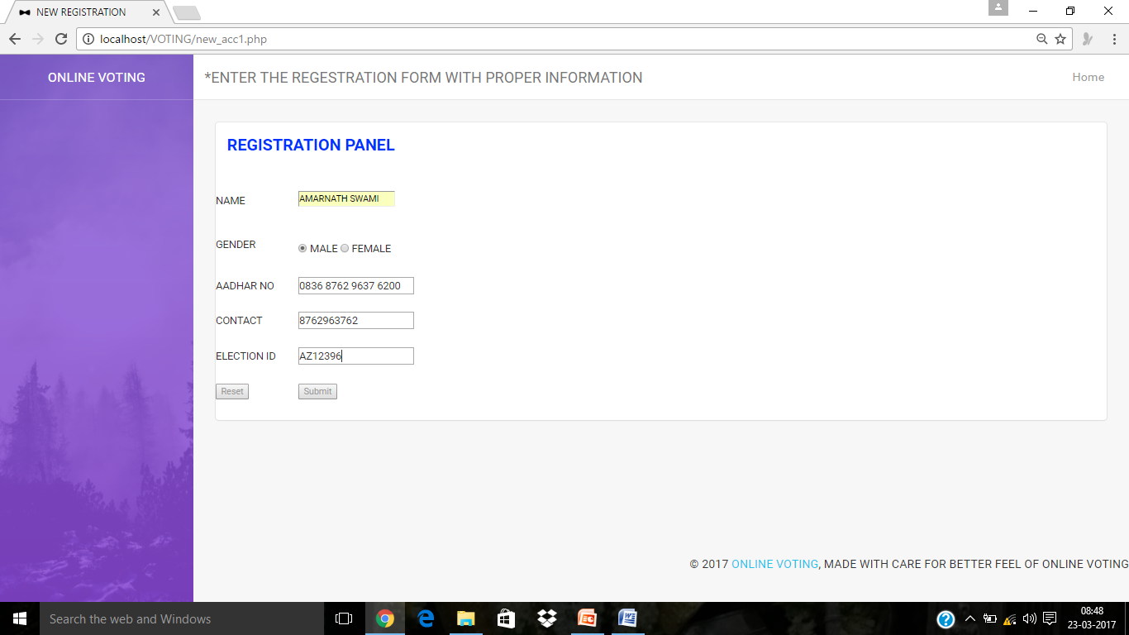
VOTER REGISTERED PAGE AND OTP GENERATION

Slide 18
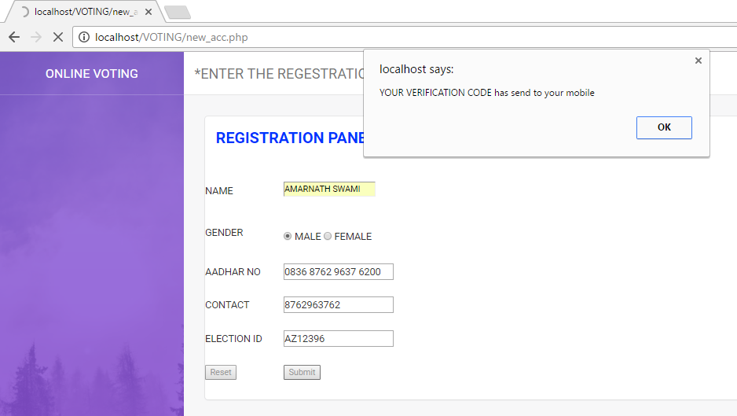
Steps to verification the register the voter

Slide 19
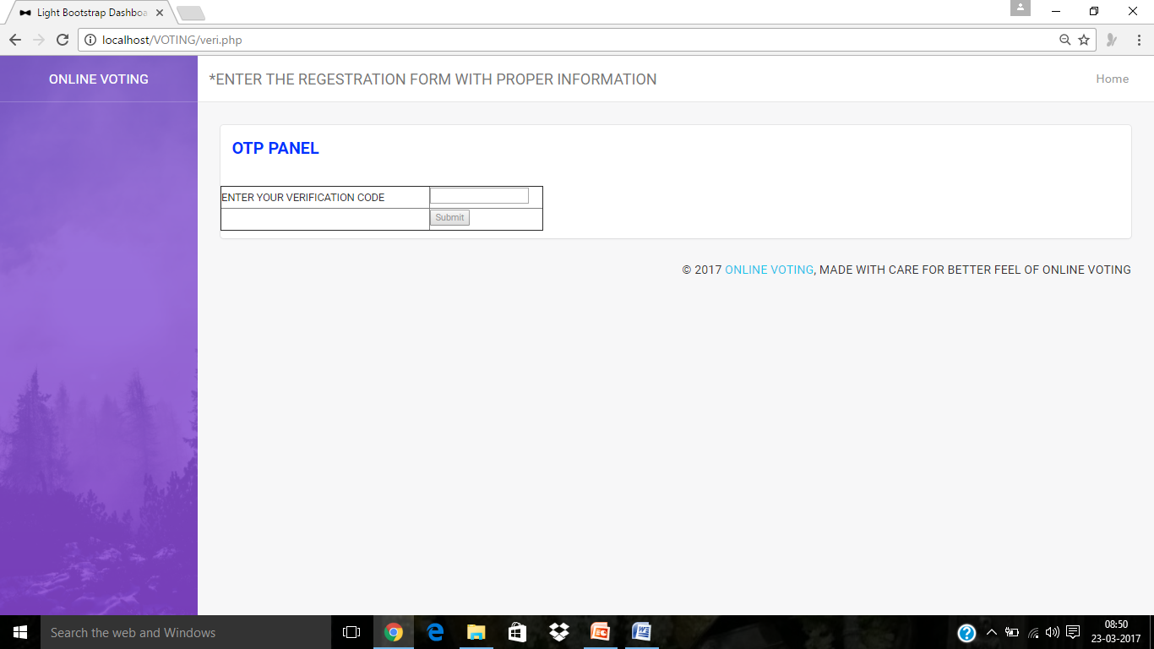
Entering the OTP

Slide 20
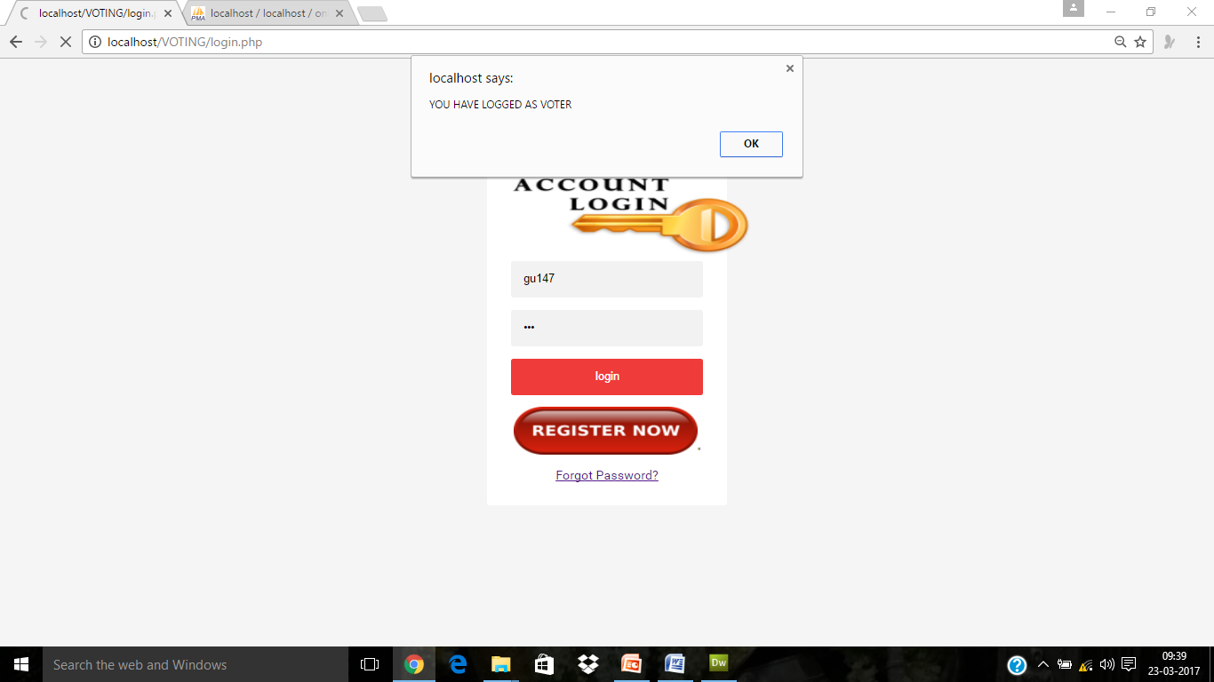
LOGGED IN AS VOTER

Slide 21
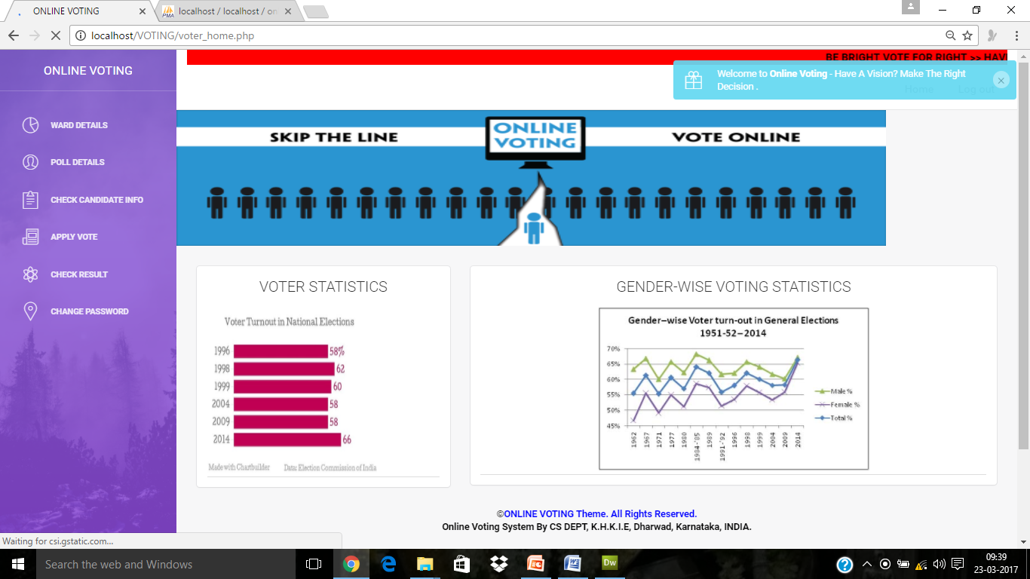
VOTER HOME PAGE

Slide 22
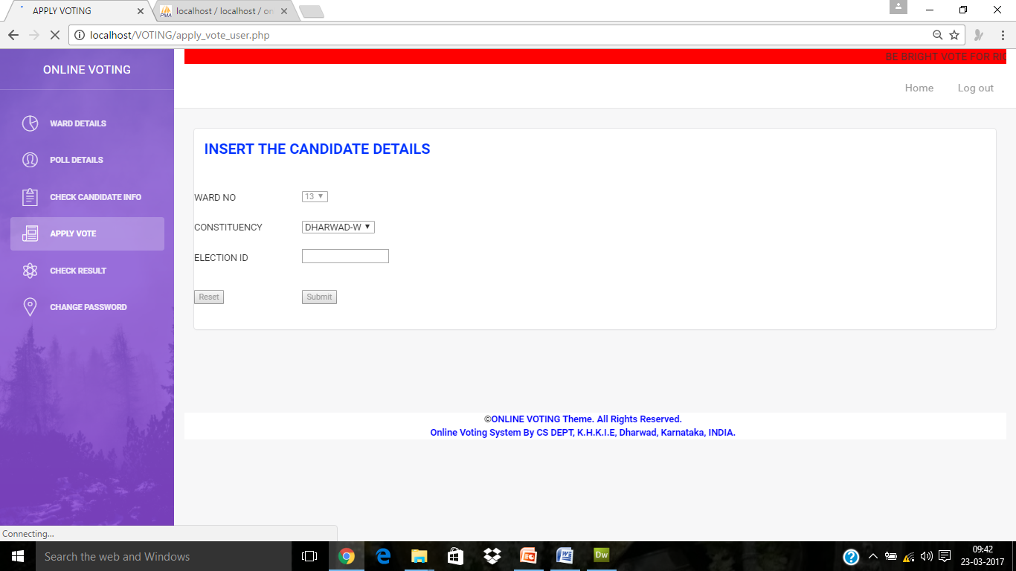
Apply vote

Slide 23
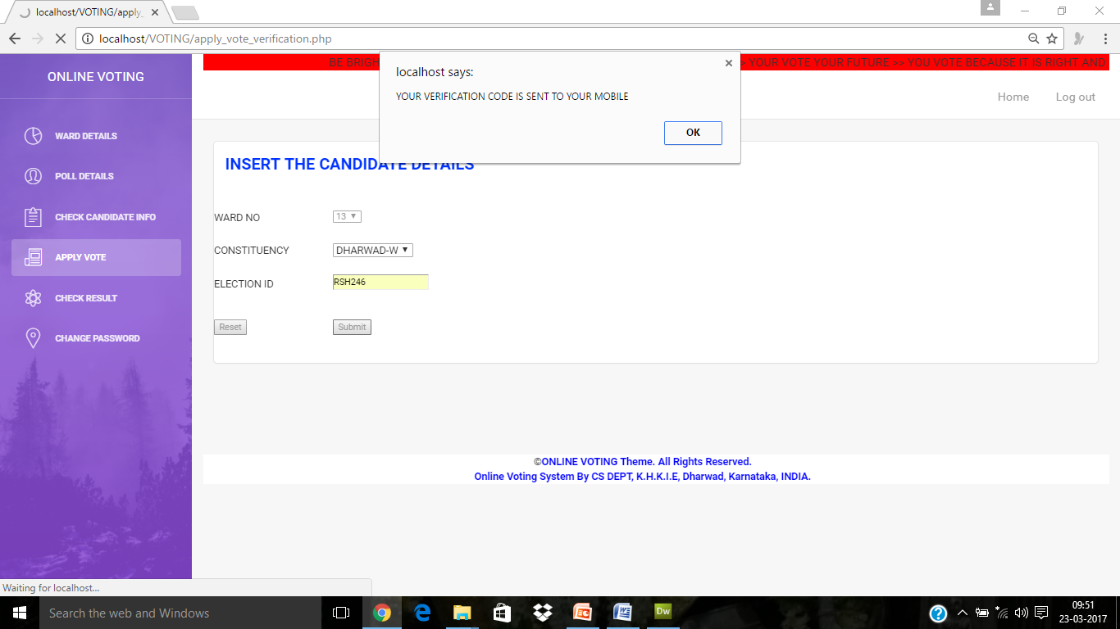
Voting process

Slide 24
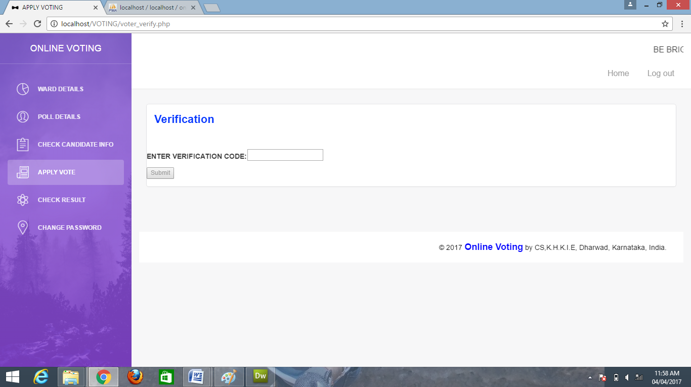
VERIFICATION PROCESS

Slide 25
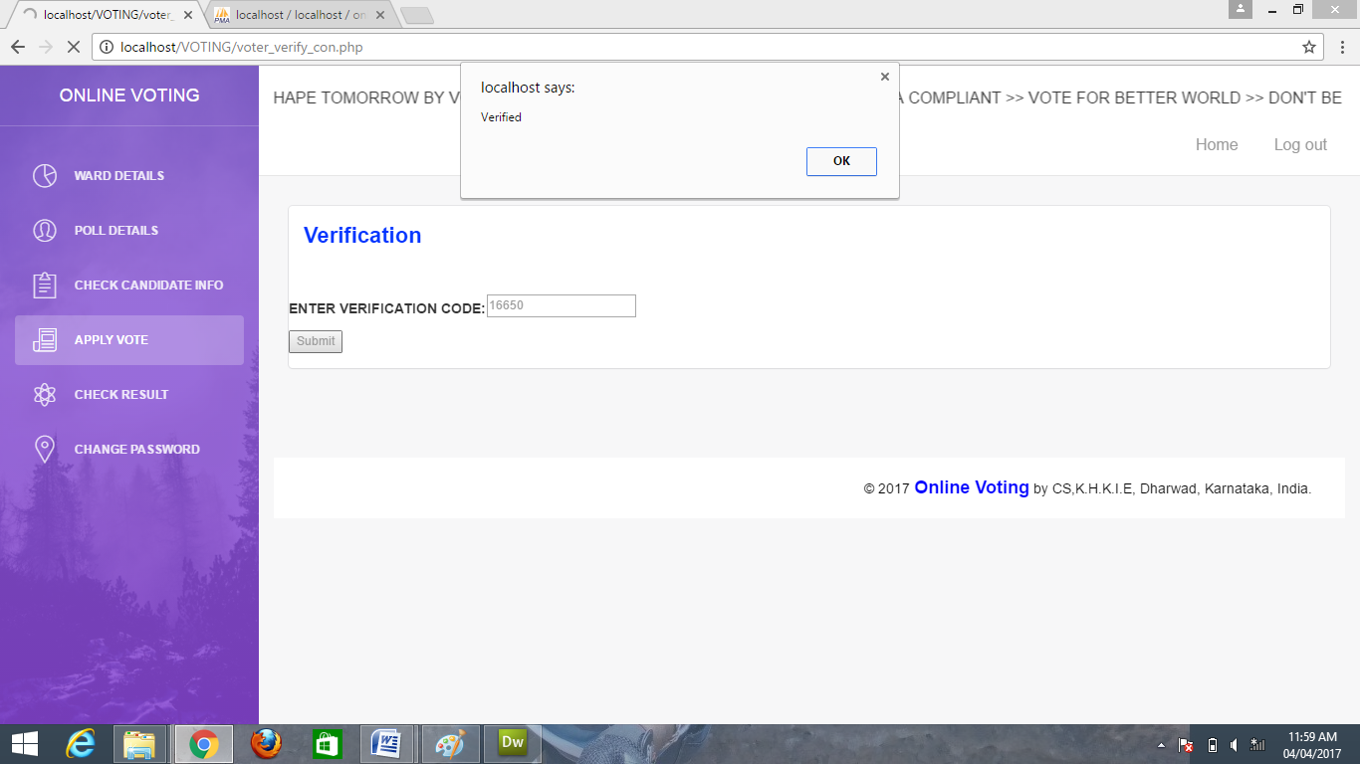
Voting process

Slide 26
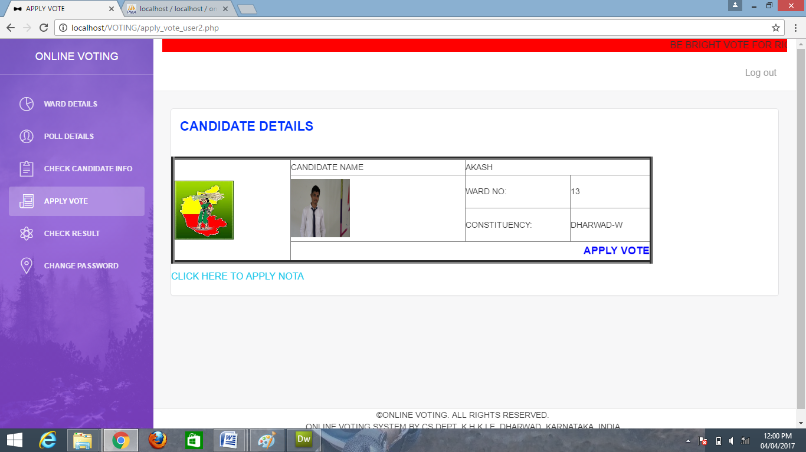

Slide 27
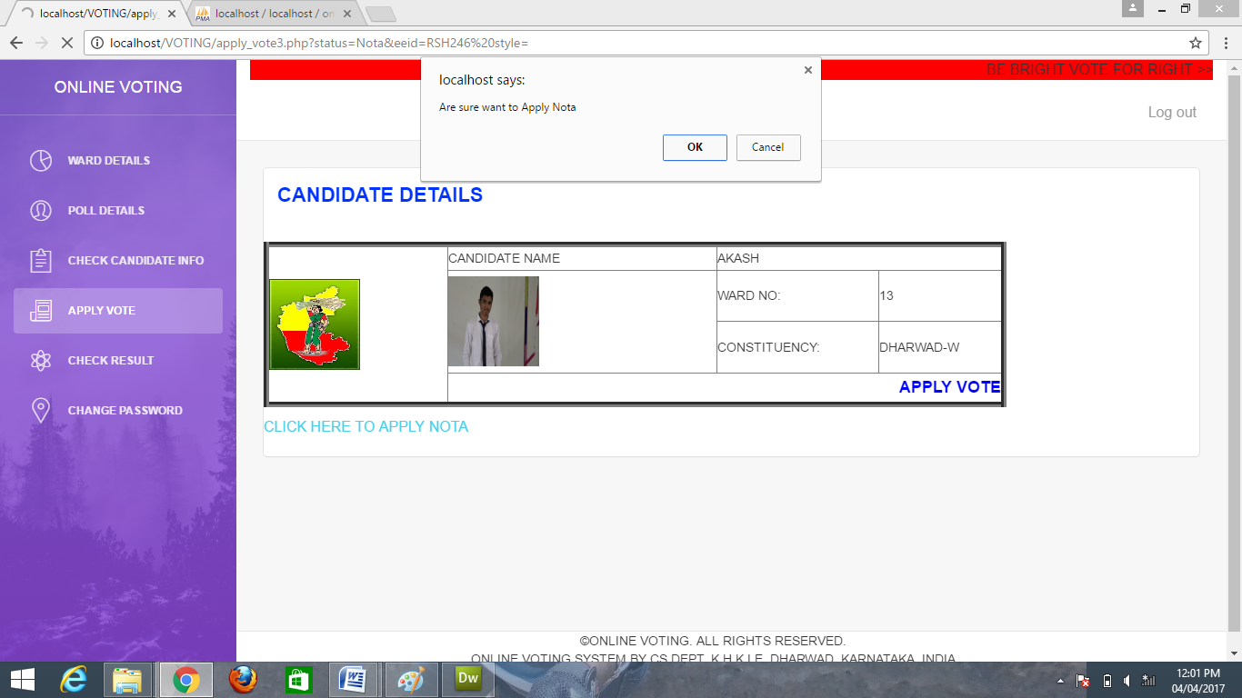
APPLIED VOTE

Slide 28
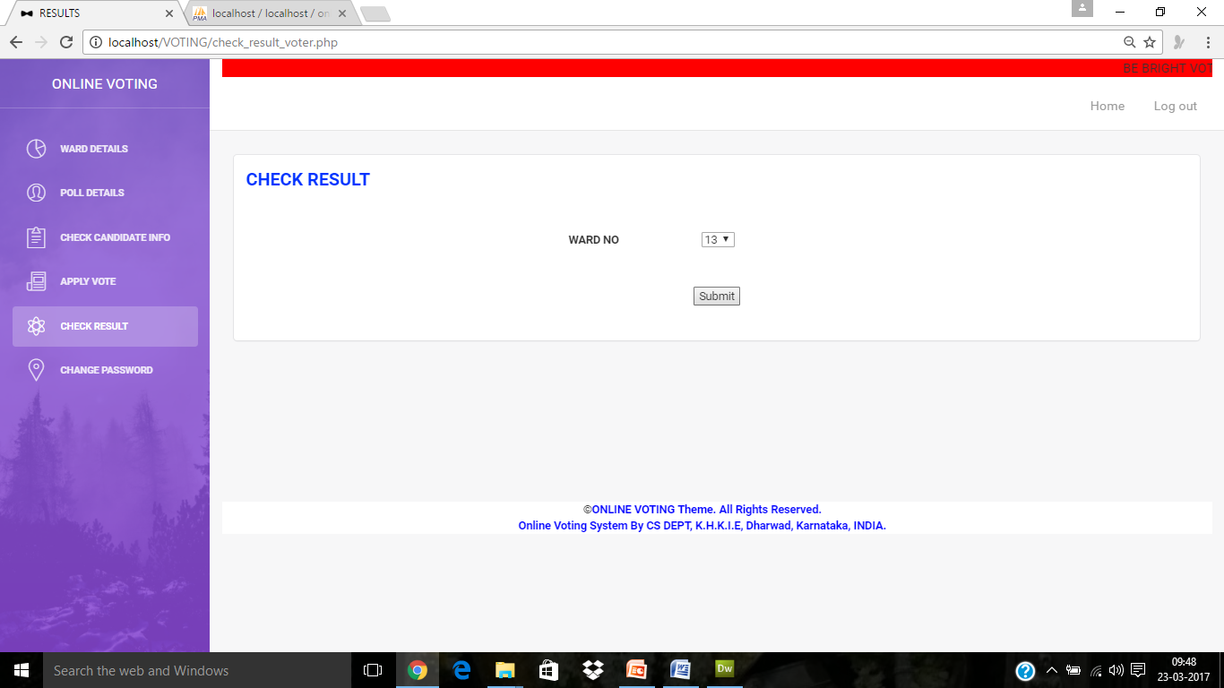
CHECK RESULT

Slide 29
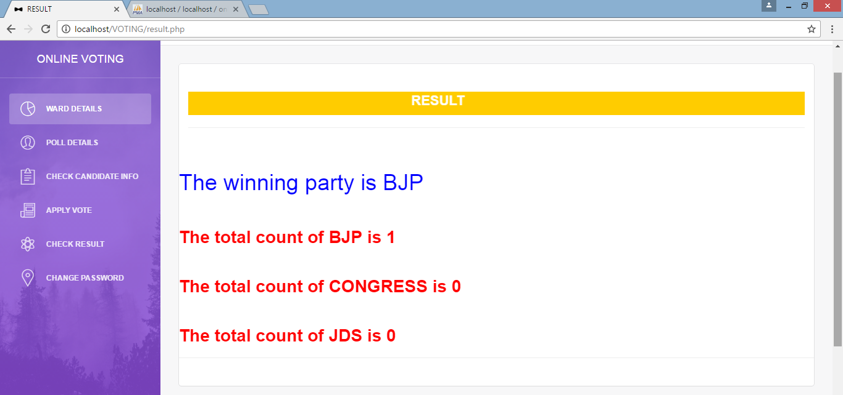
RESULT

Slide 30
THANK YOU
SUBMITTED BY:AMARNATH SWAMI

